Slide 1
Opening Lecture
3750 – Principles of Online Marketing
@SofieAndreou
SofieAndreou@Trentu.ca
@SofieAndreou Opening Lecture #SofieMarketingTips

Slide 2


Who Is Sofie?
Undergrad in Computer Science from University of Windsor
Masters of Engineering, Information Systems from University of Toronto
Bell Canada in Toronto as Customer System’s Engineer & Sales Director
Tech Startup on Bay Street as Chief Operations Officer (went public)
Founder of 123DigitalPower.com, Digital Marketing Agency. (Aka Sofie Andreou & Associates in 2002.)
50% Hands on (Clients Include)
Kawartha TV& Stereo, Knock On Wood, Cheslers Shoes & Digital Mainstreet Vendor
50% Training (Clients Include)
Esso Imperial Oil, Community Futures, DBIAs, Chambers, Northumberland Tourism, Digital Mainstreet Squads AND……
www.SofieAndreou.com

Slide 3

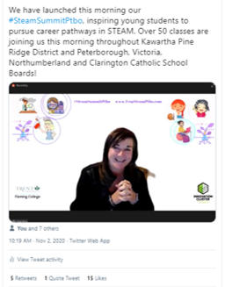
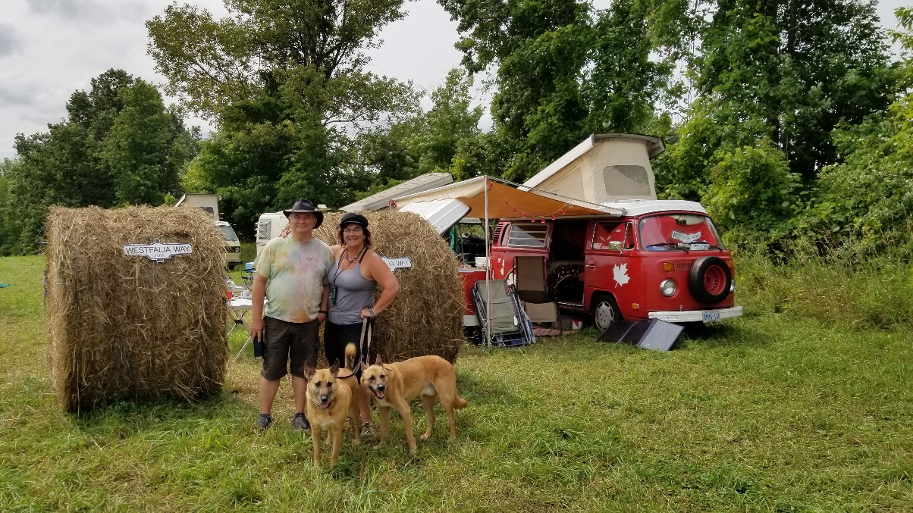
Who Is Sofie?
www.SofieAndreou.com

Slide 4
Who Is Sofie?
www.SofieAndreou.com

Slide 5

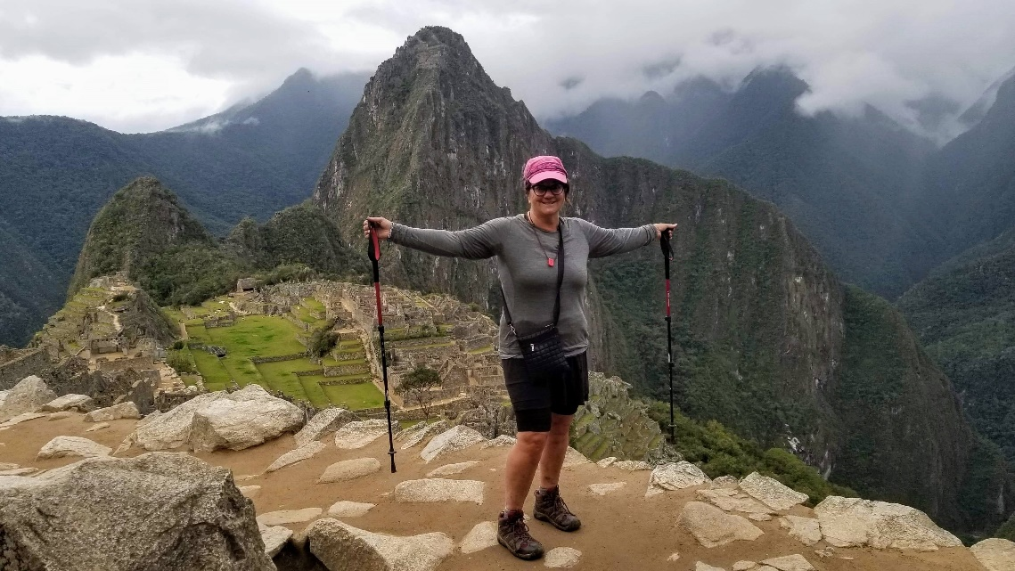
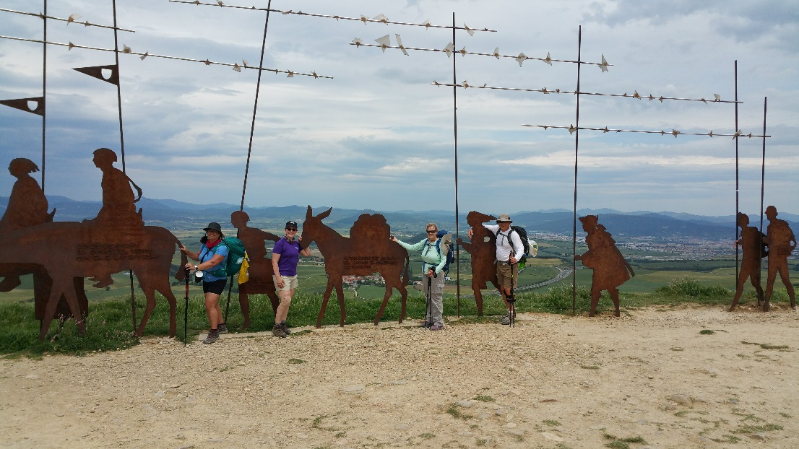
Who Is Sofie?

Slide 6
Welcome
Sofie Andreou & Associates
www.SofieAndreou.com Owner
BizMapPtbo.com Founder
Host of BizMapPtbo (TV series on Cogeco)
Past Chair Bears’ Lair
Humane Society Supporter
StartUp Peterborough Co-Founder
Past Peterborough Chamber of Commerce Board Member
Past Peterborough Women’s Business Network Board Member
Past Chair of 2019 Peterborough Women’s Awards
Recipient of the 2018 Peterborough – Kawartha Women’s Leadership Award
Recipient of 2021, 2020 Reader’s Choice Award for Online Learning & Digital Marketing
Recipient of 2019 Peterborough Chamber Marketing Awards
@SofieAndreou Opening Lecture #SofieMarketingTips

Slide 7
Welcome
Instructor: Sofie Andreou, M.Eng Email: SofieAndreou@trentu.ca
Academic Administrative Assistant: Bonnie MacKinnon Email: cois@trentu.ca
Phone (705) 748-1011 ext. 7802, OC 102.6
Workshop Leader: Thomas Hughes Thughes@trentu.ca
Technical support: Learning System Team E-mail: LearningSystem@trentu.ca
Phone: 705-748-1010 Toll-free: 888-739-8885 ext. 1010
@SofieAndreou Opening Lecture #SofieMarketingTips

Slide 8
Welcome
PRIMARY TEXTBOOKS:
Andreou, Sofie. Your Social Strategy - Post Pandemic - 2021
Available on the Blackboard, Module One.
@SofieAndreou Opening Lecture #SofieMarketingTips

Slide 9
Grading Scheme:
Assignment 1 5% Due Thursday Sept 30th by 2pm
Assignment 2 5% Due Thursday Oct 14th at 2pm
Midterm Exam 20% Online Oct 19th at 9am until Oct 21st at 2pm
Assignment 3 25% Due Wednesday Dec 1st by 2pm
Blackboard Discussion 20% Weekly Discussion Participation
Final Exam 25% During Exam Period
@SofieAndreou Opening Lecture #SofieMarketingTips

Slide 10
Grading Scheme:
Assignment 1 – 5%. Due Thursday Sept 30th by 2pm
Please choose one of Chapters 1 to 7 from the textbook,Your Social Strategy - Post Pandemic - 2021 being released on the Blackboard and submit an example which would add value to that chapter!
Your deliverables are:
2 Page PDF Submitted on the Blackboard.
Hyper Link to the best practice example you are submitting.
ScreenShot of the best practice example you are submitting.
Answering three questions:
How do you think this business is managing this best practice? 3 Marks
How do you think this best practice has helped this business? 4 Marks
Hyper Link to the timely relevant best practice you’ve chosen. 3 Marks
Note: For your deliverables use relevant and timely examples. Relevant, means it adds value to the chapter you’ve chosen. Timely means within the past month. Links to the example need to be functional.
@SofieAndreou Opening Lecture #SofieMarketingTips

Slide 11
Grading Scheme:
Assignment 2 – 5%. Due Thursday Oct 14th by 2pm
Please choose one of Chapters 8 to 12 from the textbook,Your Social Strategy - Post Pandemic - 2021 being released on the Blackboard and submit an example which would add value to that chapter! Your examples might be rolled into the next release of this textbook.
Your deliverables are:
2 Page PDF Submitted on the Blackboard.
Hyper Link to the best practice example you are submitting.
ScreenShot of the best practice example you are submitting.
Answering three questions:
How do you think this business is managing this best practice? 3 Marks
How do you think this best practice has helped this business? 4 Marks
Hyper Link to the timely relevant best practice you’ve chosen. 3 Marks
Note: For your deliverables use relevant and timely examples. Relevant, means it adds value to the chapter you’ve chosen. Timely means within the past month. Links to the example need to be functional.
@SofieAndreou Opening Lecture #SofieMarketingTips

Slide 12
Grading Scheme:
Assignment 3 – 25%. Due Wednesday Dec 1st by 2pm
Assignment 3 is the detailed digital marketing proposal for your Case Study. You will recommend two digital marketing solutions to help your Case Study meet its goals. You will indicate how your two digital marketing solutions will benefit the Case Study, how they will measure success, and recommend how each digital marketing solution should be implemented.
Your deliverables are:
a 15-page maximum written component submitted in PDF format.
You are to ensure that all deliverables are targeted at your Case Study, and are in easily-understood language and terms that the case study business owners would understand.
Marks will be allocated as follows:
20% for professionalism and creativity of your submissions
40% for identifying two different relevant beneficial creative online digital marketing solutions
40% for implementation plans around each of your two online digital marketing solutions proposed
The best of the projects might be given to be business owners in the Case Studies, used on LinkedIn or used as resource material for future classes.
@SofieAndreou Opening Lecture #SofieMarketingTips

Slide 13
Grading Scheme:
20% Class Discussion Sept to Dec 7th
Class participation grades will be based on your timely quality engagement within a week of a specific question posted on the Blackboard Discussion area, as well as any engagement you individually create. Lecture in Module 1 reviews how to succeed in this class and how to participate within the discussion. Questions will be designed to help you succeed on the final exam and your Assignment 3.
@SofieAndreou Opening Lecture #SofieMarketingTips

Slide 14
Grading Scheme:
MIDTERM EXAM – 20%. Open Online Oct 19th at 9am until Oct 21st at 2pm
The Midterm Exam will be available in the Blackboard Learning System assessment area. Once you start you will have two hours to complete the Midterm Exam. DO NOT walk away. DO NOT start it after noon on the 21st, as you will be cut off at 2pm and it will NOT be submitted.
The Midterm Exam will consist of 100 multiple-choice questions. It will be based on all of the material covered since the beginning of the course, including all of the assigned readings from the main textbook, Class questions and LinkedIn class participation questions, and the video lectures.
@SofieAndreou Opening Lecture #SofieMarketingTips

Slide 15
Grading Scheme:
FINAL EXAM – 25%. In Person: scheduled during final exam period
There will be a 3-hour, closed-book Final Exam comprised of bullet form written free-hand questions and multiple choice questions. The Final Exam will be based on all reading from both books, material covered since the start of term, as well as the case studies you did not choose as your final project.
@SofieAndreou Opening Lecture #SofieMarketingTips

Slide 16
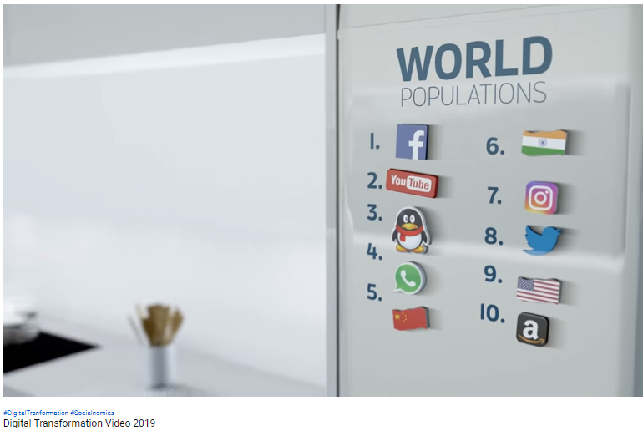
WHY
https://www.youtube.com/watch?v=6k_G_h41ZaQ&t=9s
@SofieAndreou Opening Lecture #SofieMarketingTips

Slide 17
TRANSMEDIA DIGITAL REVOLUTION
A few of the technologies that have aligned to enable this transmedia digital revolution include:
● Bandwidth
● Geo-location technology
● Radio frequency identification (RFID)
● Social commerce
● Smart phones
● Online databases
● Measurement and management tools
● Search engines
● Stable social media platforms
● Streaming video
● Personalization & Targeting
● Continual creation of new software, or applications (Apps), that utilize the above technologies
@SofieAndreou Opening Lecture #SofieMarketingTips

Slide 18
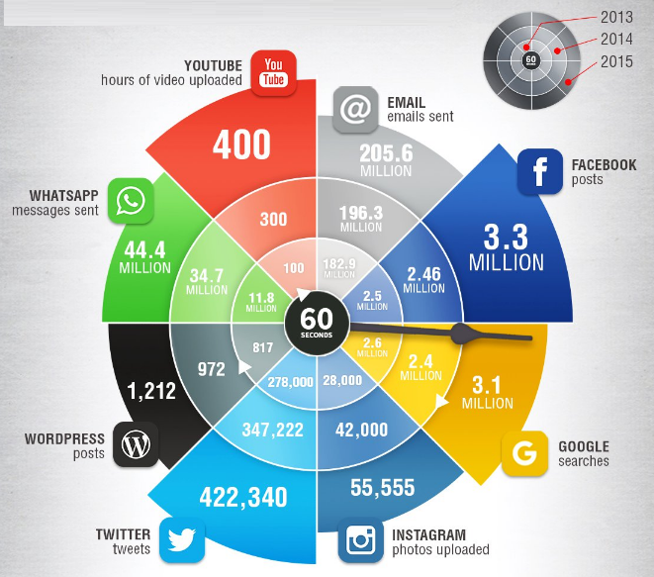
What’s happening every 60 sec..
http://www.smartinsights.com/internet-marketing-statistics/happens-online-60-seconds/
@SofieAndreou Opening Lecture #SofieMarketingTips

Slide 19
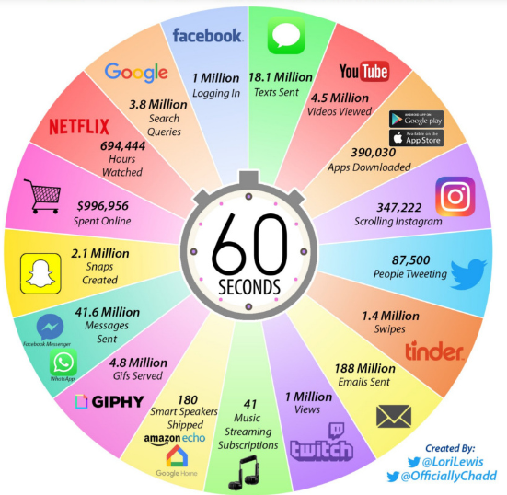
What’s happening every 60 sec..
https://www.visualcapitalist.com/what-happens-in-an-internet-minute-in-2019/
@SofieAndreou Opening Lecture #SofieMarketingTips

Slide 20
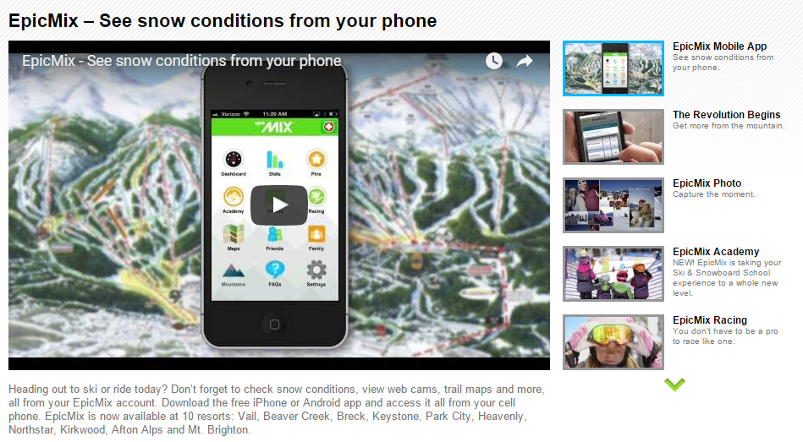
EpicMix.
http://www.epicmix.com/How-It-Works.aspx#epicmix.
@SofieAndreou Opening Lecture #SofieMarketingTips

Slide 21

Sales Funnels’ Paradigm Shift
@SofieAndreou Opening Lecture #SofieMarketingTips

Slide 22
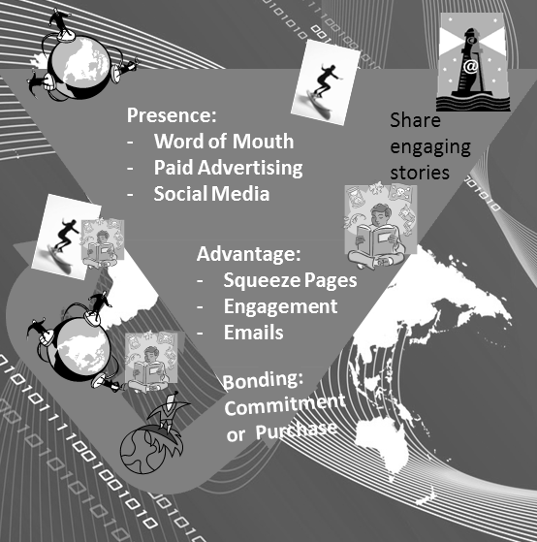
Sales Funnels’ Paradigm Shift
@SofieAndreou Opening Lecture #SofieMarketingTips

